Slide 1
Comparative Study
The human body is something that will always be present in life. There’s no way around the human body. For some, the human body is a private aspect of life, however, for others, the human body is nothing more than art. The human body, as it is interpreted many ways, is viewed differently by many artists- including local artist John G. Balsley, international artist Gian Lorenzo Bernini, and international artist Pablo Picasso. The three of these artists have a major theme in common, however, they come from different time periods throughout history and present day. Through art, the body is interpreted in many different ways- whether it be realistic or not. This comparative study will prove just that.

Slide 2
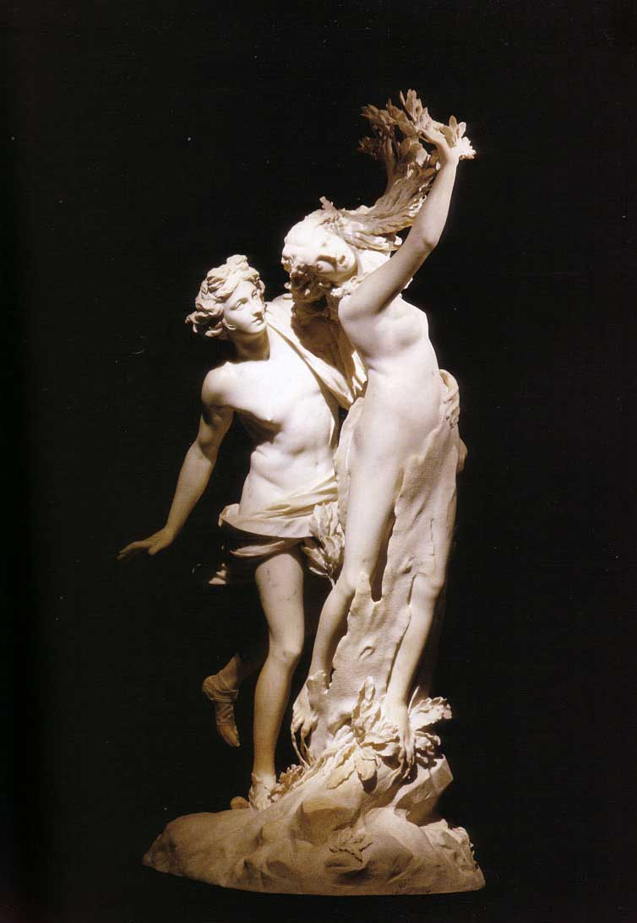
Gian Lorenzo Bernini
Bernini was known for his Baroque style pieces during the 1600s. He was a sculptor and architect who created forms of the human body. His work was more precise, chiseled, and realistic. Along with the Baroque art movement, Realism is also a movement where his work is present. Bernini was first brought to my attention during my sophomore year of high school. His work greatly intrigued me based on the way he glorified one’s body.
Gian Lorenzo Bernini
“Apollo and Daphne”
http://www.galleriaborghese.it/borghese/en/edafne.htm

Slide 3
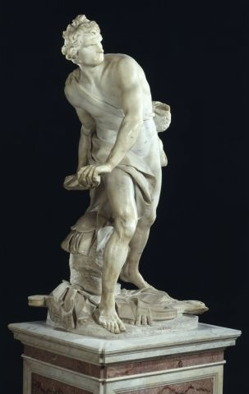
David by Bernini
This sculpture is quite muscular and chiseled to almost make this man dreamy, so to speak. The face is also precise as well as the body and other detail throughout.
Certain features like the feet are extremely precise and detailed.

Slide 4
Apollo and Daphne vs. David
The male in both sculptures are very chiseled and defined, almost to prove a sense of masculinity.
The legs on every figure are a main focal point. A lot of attention is given to those particular aspects of the body.

Slide 5
John G. Balsley
When working with the human body, John G. Balsley does not take a literal approach to the fact. When creating a body, he uses industrialized products to create a sculpture. Not only does he create the human form, but he also gives the pieces a name- a life. Some include “Mr. Taphasm,” “Mr. Secret,” and “Mr. Current.” He is currently a local artist in Milwaukee, Wisconsin whom I discovered at a local art gallery.

Slide 6
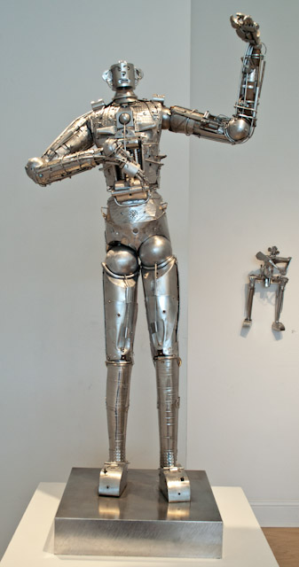
Mr. Taphasm
There are also some unrealistic features, such as the extremely long arms and legs. The arms on this figure are just about as long as the legs are.
Joints are given to this character to give him a sense of reality. It is quite obvious that a realistic person is not made out of metal and such materials, however, certain features make him real.

Slide 7
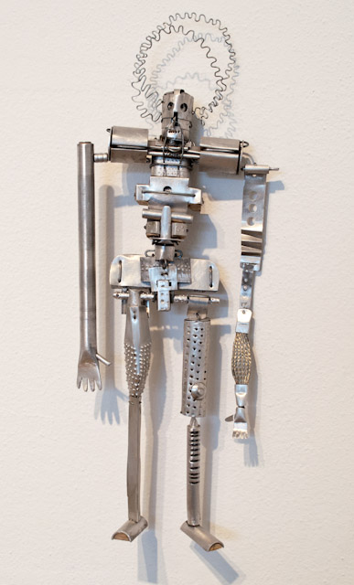
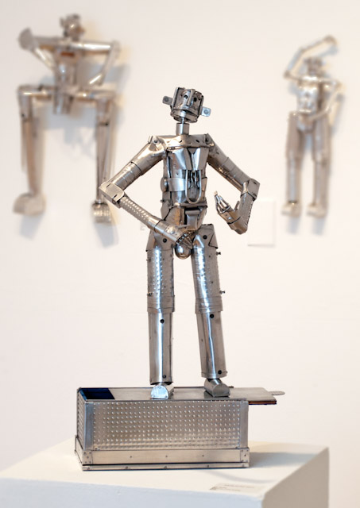
Mr. Current
More from John G. Balsley…
Mr. Secret
Both figures have many similarities, including the extended arms and legs. The heads of both characters are tiny compared to the rest of the bodies as well. On the more unrealistic side of the two figures, the proportions are extremely far off.

Slide 8
Mr. Taphasm vs. Apollo and Daphne
In both of these sculptures, an arm is raised to the upper right hand corner. This can infer that something is being praised, or honored. There is one figure which is taking lead over the entire scene in both sculptures as well.
Mr. Taphasm by John Balsley (left), Apollo and Daphne by Bernini (right)

Slide 9
Pablo Picasso
Picasso’s work pertained to the human body, however in a more abstract way. He doesn’t necessary glorify the human body, but he uses a multitude of colors that suggest that he looked at the body in a magnificent way. He goes far beyond the surface in his art. His work was created during the early and mid 1900s, so as far as John Balsley and Bernini go, these three artist created their works in much different time periods. This could also cause for the major difference in the way that the human body was perceived by the three of these artists.

Slide 10
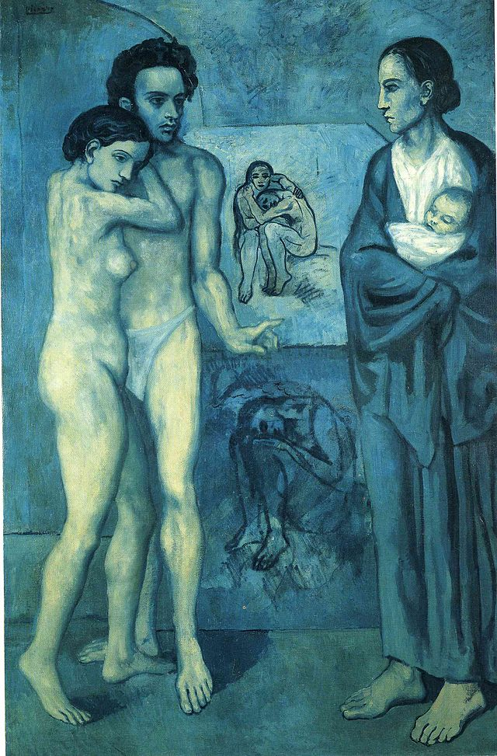
La Vie
By Pablo Picasso
Picasso uses multiple people in many of his paintings. His humans are more realistic than either Balsley or Bernini’s work.

Slide 11
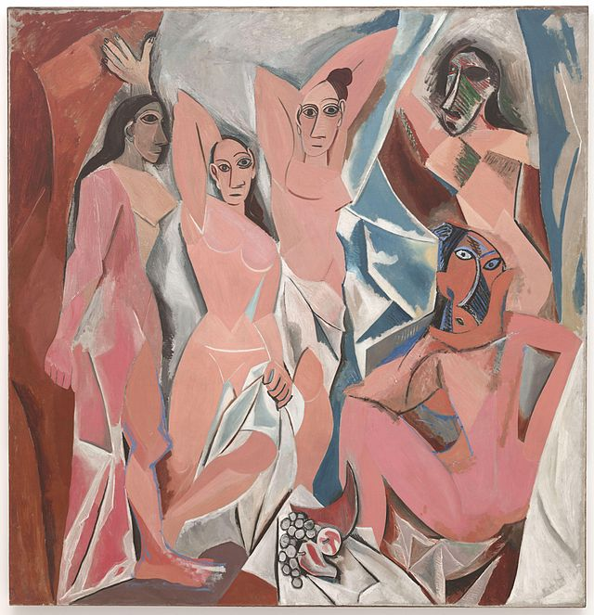
Le Demoiselles d’Avignon
None of the faces on these figures suggest that they are realistic. The faces are deformed and while you see a sense of normality on a couple pf the faces, the remaining faces are complex and abstract.
The bodies have no form or particular shape, thus suggesting that bodies all differ from one another. On some of the figures, the bodies have very pointed edges, while the other figures are well rounded.

Slide 12
La Vie vs. Le Demoiselles d’Avignon
A particular hue/color is represented throughout the entire paintings. Blue is extremely present in La Vie and pink is extremely present in Le Demoiselles d’Avignon.
The figures in La Vie are more natural vs. the figures in the opposite painting, where they are far more abstract.

Slide 13
La Vie vs Apollo and Daphne
The fact that the naked human body takes place in both works of art makes them similar. Furthermore, there are multiple people in both pieces with one main focus.
Apollo and Daphne is more graceful in the sense that the entire piece flows. La Vie can be interpreted by a means of two young lovers getting caught having sexual affairs, potentially by the mother of one of the two. The baby in the mother’s arms can ultimately represent the consequence that will occur if they continue to do what they are.
La Vie by Pablo Picasso
Apollo and Daphne by Bernini

Slide 14
Le Demoiselles d’Avignon and Mr. Secret
The figure in the center and the figure on the top right corner of Le Demoiselles d’Avignon both relate to Mr. Secret since they have very sharp, precise curving to the body- particularly in the arms.
Le Demoiselles d’Avignon by Pablo Picasso
Mr. Secret by John Balsley

Slide 15
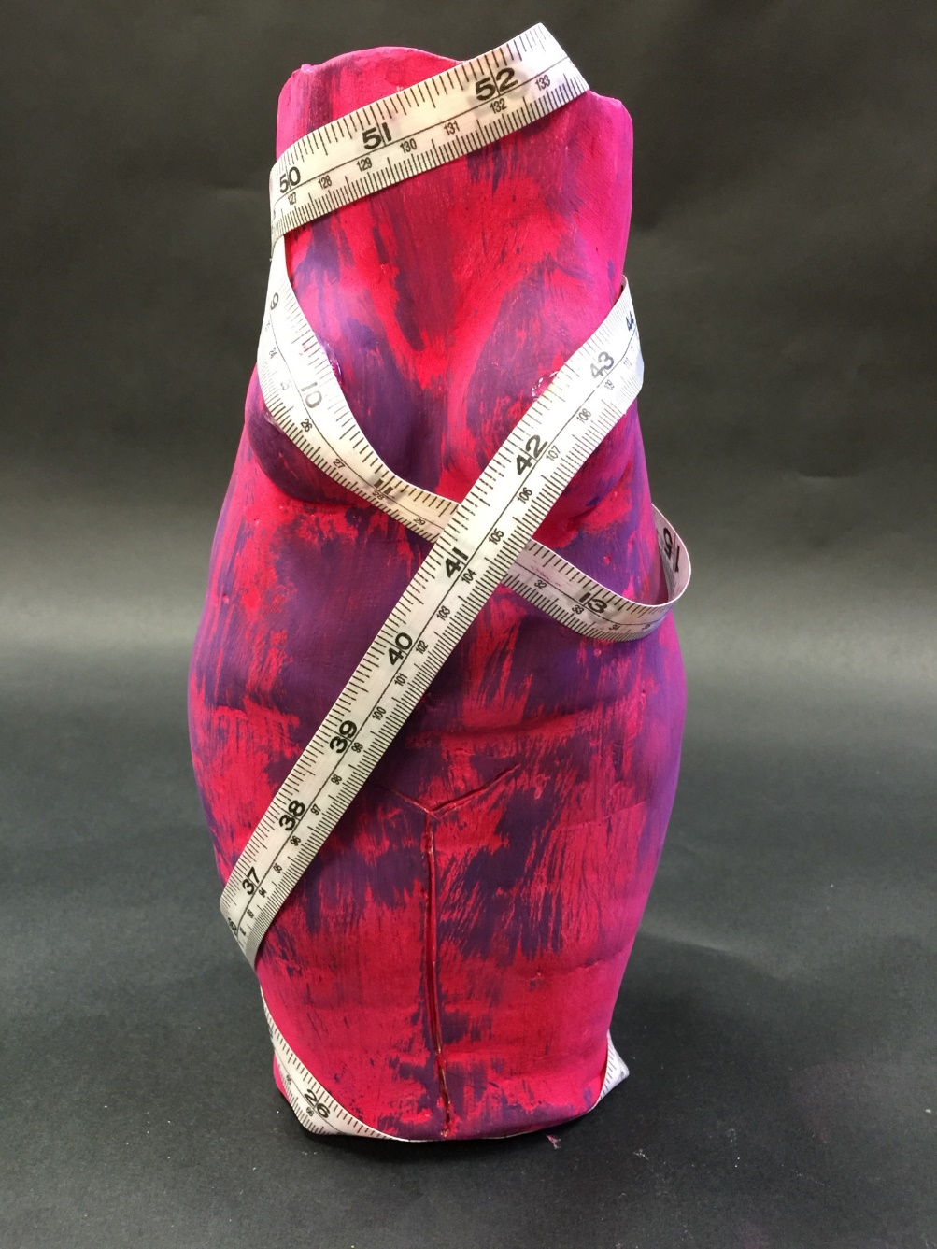
Obsession
Obsession is a piece that I created to represent the imperfections within the human body. From the large belly, to the sagging breasts, it’s represented throughout the entire piece. It was most inspired by the piece La Vie by Pablo Picasso for a various number of reasons.
The breasts of this woman are large and sag. This is just another aspect of the piece that suggests it to be imperfect.
This piece also has large thighs, with ripples to represent cellulite in the body. It’s a natural occurrence in both men and women throughout the generations, which is targeted in both negative and positive respects.
The measuring tape symbolizes the lack of care of the imperfect body.

Slide 16
Obsession
La Vie
Even though, in La Vie, the discoloration of the skin is to represent shading throughout the body, in my piece, Obsession, it is to highlight the imperfections of the human body.
La vie inspired me to create a piece where the belly of the lady is large and round. This allows people from all generations to view the normality of this aspect.

Slide 17
Le Demoiselles d’Avignon
Obsession
The carelessness of the exposed bodies in Le Demoiselles d’Avignon by Pablo Picasso really inspired my piece. I was able to easily create the naked clay piece because Le Demoiselles d’Avignon really showed how it’s not necessarily a bad thing to do.
The dysfunction of Le Demoiselles d’Avignon is also shown in Obsession with all of the imperfections shown within the entire piece.

Slide 18
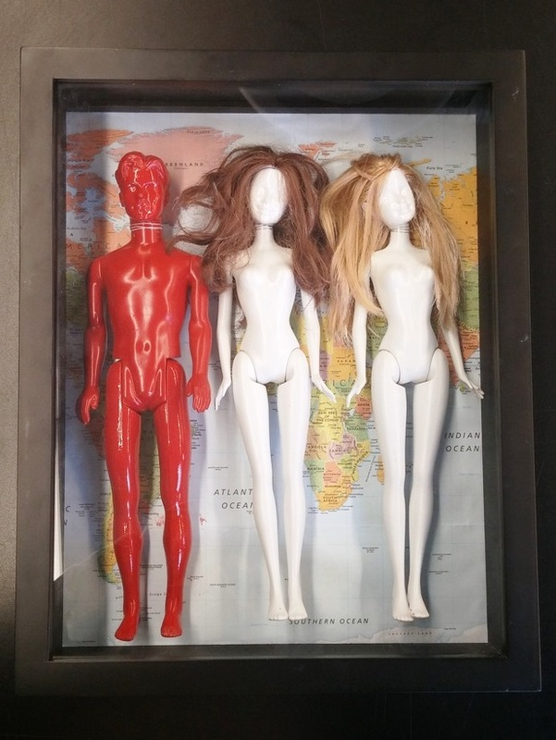
Control
The tilt of the head in both Mr. Current and the two female dolls in Control suggest that the body movement represents something on a much deeper level. This either lets an audience wonder what the piece may represent or allows them to figure it out on their own.
Mr. Current
Since Mr. Current has his arms down to his sides, it seemed like the best fit to do the same with my dolls in Obsession. The legs and arms are both stiff and down the sides in both pieces, due to the inspiration from Mr. Current.

Slide 19
Obsession
Control
Overall, these pieces displayed throughout have truly inspired me to create unique art pieces of my own. My own particular pieces are similar in certain ways, however, they do differ from each other in tremendous ways as well. As well as resembling other pieces of my own, they do resemble those displayed in this document. Many other works of art from many different artists have inspired me to add particular aspects into my artwork.

Slide 20
Works Cited
http://www.galleriaborghese.it/borghese/en/edafne.htm
https://www.khanacademy.org/humanities/monarchy-enlightenment/baroque-art1/baroque-italy/a/bernini-david
http://www.johngbalsley.com/public/view_all.php
http://www.pablopicasso.org/la-vie.jsp
http://www.moma.org/collection/works/79766

