Slide 1
At first glance, there is no general connection linking all of my work together. Although it’s not completely obvious, the idea of passion is the main goal of all of my pieces. Passion in what I, as an artist, love- or passion such as culture and the world around me. However, in most of my earliest pieces, it is quite apparent that the body and the idea of lust and desire is quite frequently displayed. Later on throughout my career in IB art, my focus changes to war. Every aspect of every piece of my work is due to my experiences and are affected by the world around me.
The majority of my pieces, including Desire, Unidentifiable, Control, and Obsession, are more relatable to the human body and the whole idea of lust. Furthermore, sexuality was quite frequently present along with gender roles and how they affect many parts of life. Control was the one piece which specifically explored the gender role idea. At the time of creating these pieces, I was just beginning to figure things out about not only myself, but everything incorporated into these pieces as well. The idea was to show how almost vulnerable women can be toward men, yet still have a sense of reality.
The intention behind every one of these projects was to get a viewer to relate in any sort of way. Whether the relatable way had the exact reasoning as my own or the reason was completely farfetched and the opposite of mine, feeling connections through my artwork was the main goal. I would never want to leave the viewer questioning one of my pieces, but if that was ever what happened, I would love for the possibilities to be endless. Having the colors vary throughout every piece was to set different tones throughout all of them.
The darker pieces were originally because those aspects of my life at the time were almost a mystery. Some of the pieces with the brighter hues are due to me attempting to figure these aspects out. Anything with bright shades of red were essentially the represent the control that a certain thing has on another.

Slide 2
My next group of artwork includes Me, Life, and Fiesta. The goal of these three pieces was to represent my life. Within them all, a lot is going on. The three of them all contain bright colors throughout the entire piece and there is a lot to feast your eyes on throughout them all- especially in Life. That tryptic has three separate areas that all connect to create one large piece.
Furthermore, some of my favorite colors were put into these pieces. That was another one of my ways of representing myself within all of these works. It was also a way of making sure my piece differed from my inspirational pieces and represented everything I intended to represent.
My last group of work had to do with war. Many different aspects of my life at the time influenced this particular group of work. I wanted to represent what parts and branches of the war were most influential to my life at the time. The United States Navy played a crucial part of my life and my family’s life, so it meant a great deal to me to be able to create artwork of my own that separated how others view war from the way I, myself, view the war.
George, M16A2, Ship, and Forgotten America were four of the pieces that tied into the entire war theme for me. None of these pieces are related to each other in a collaboration sense, however they are in the sense of theme. With these four works of art, I wanted my audience to be able to relate to certain aspects along with me and to get to know the people who influenced this part of my life, through a portrait of a sailor.
I believe that the ways, in which I carried out my work, were the best ways to do so. Everything which I attempted to create was completed in the way I wanted, or similar to how I wanted to do so.

Slide 3
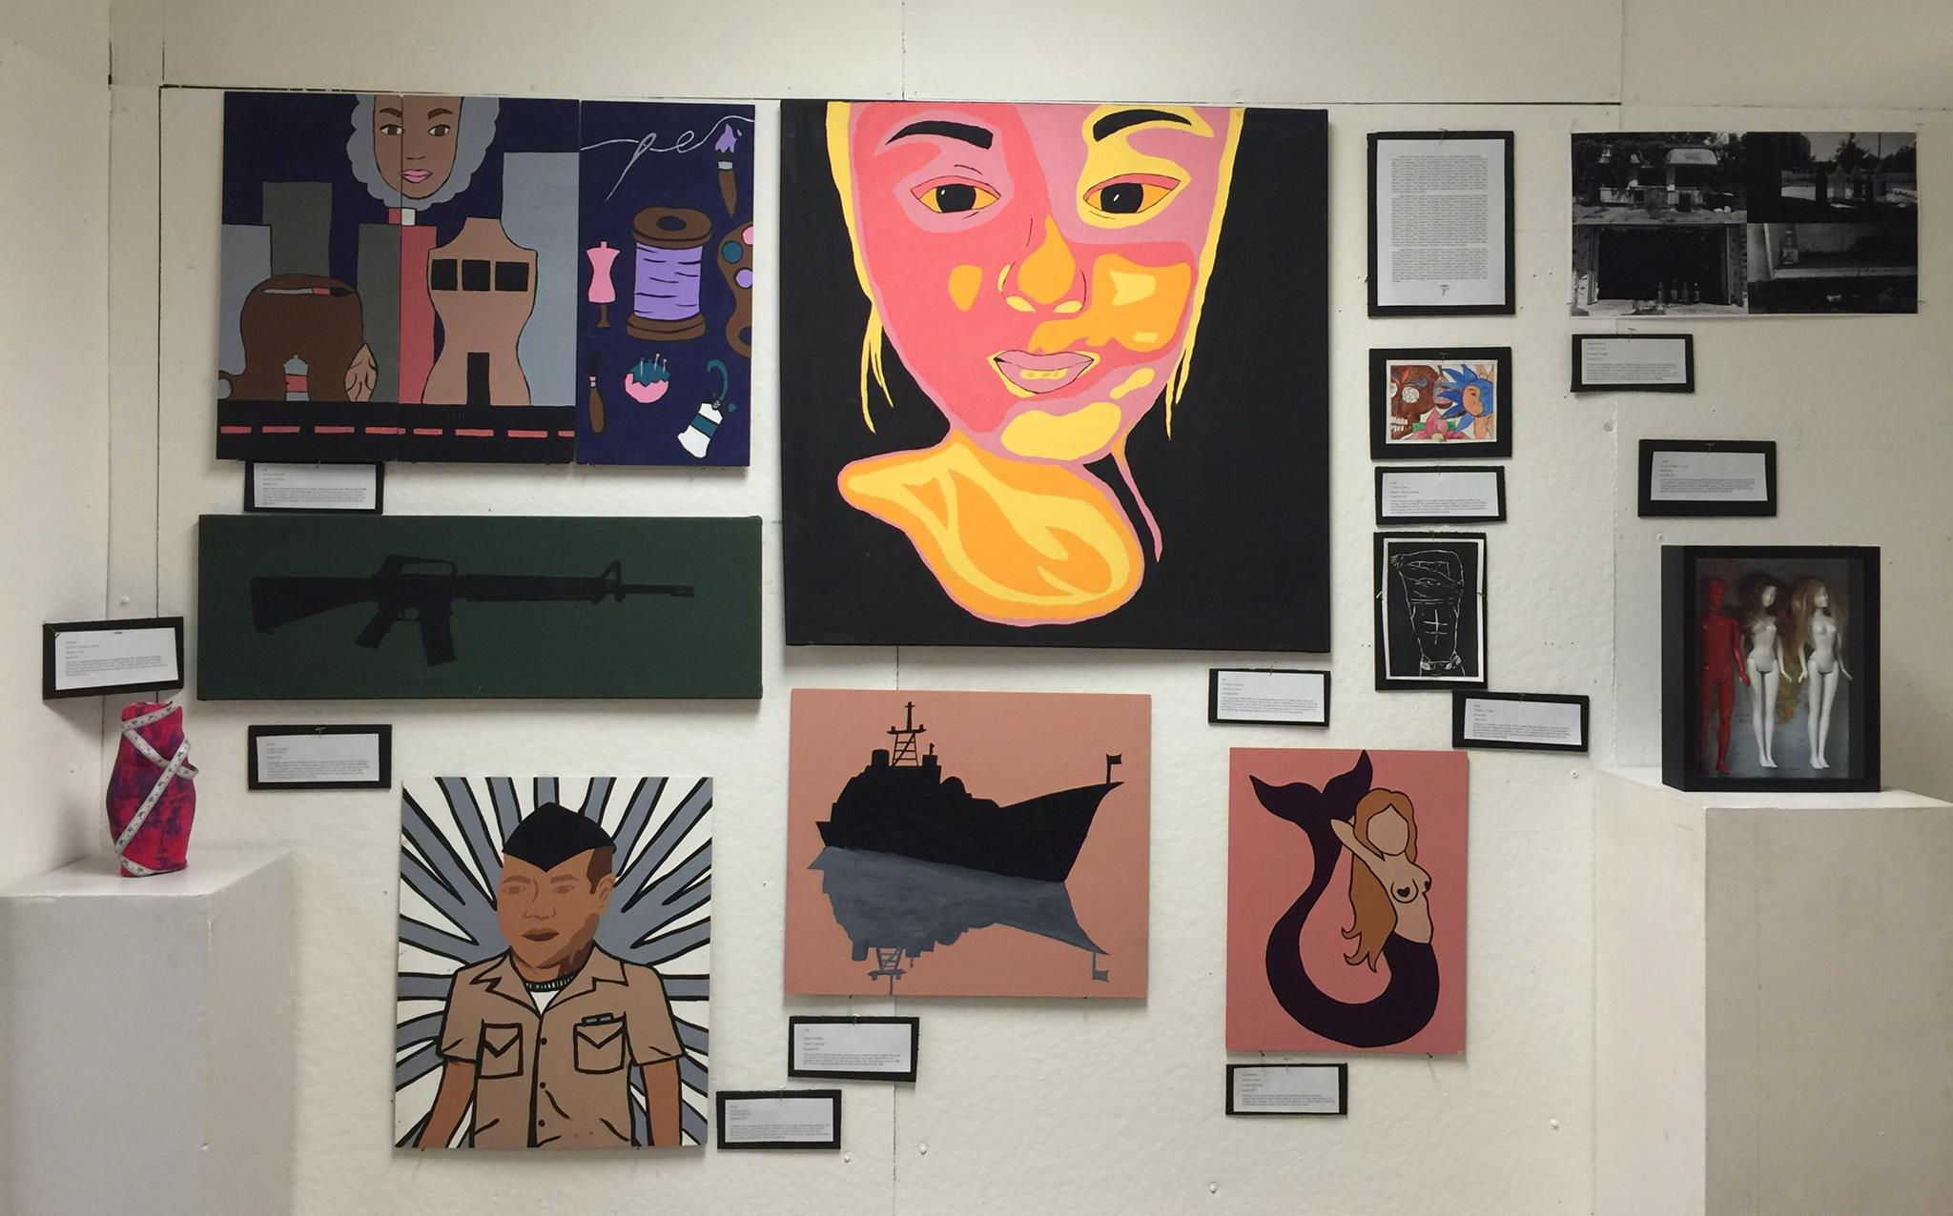

Slide 4
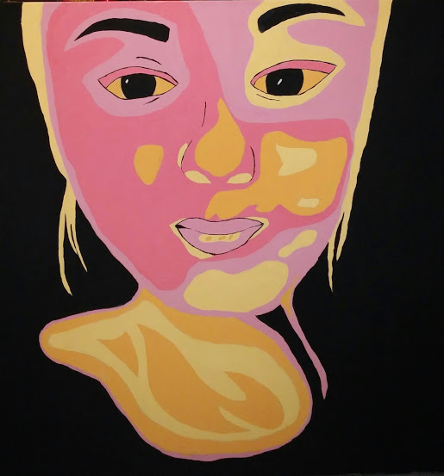
ME
91.44cm x 91.44 cm
Acrylic on Canvas
November 2014
“Me” was created with intentions of resembling Shepard Fairey’s “Hope.” The goal I attempted to achieve was a modern street art look, which is what Fairey is known for. Since the piece is a self-portrait, I still wanted it to resemble myself, so I incorporated different shades of the colors I am most fond of. The painting alone was not the entire project- it was only half the fun. Stretching the canvas myself, however, was only the beginning.

Slide 5
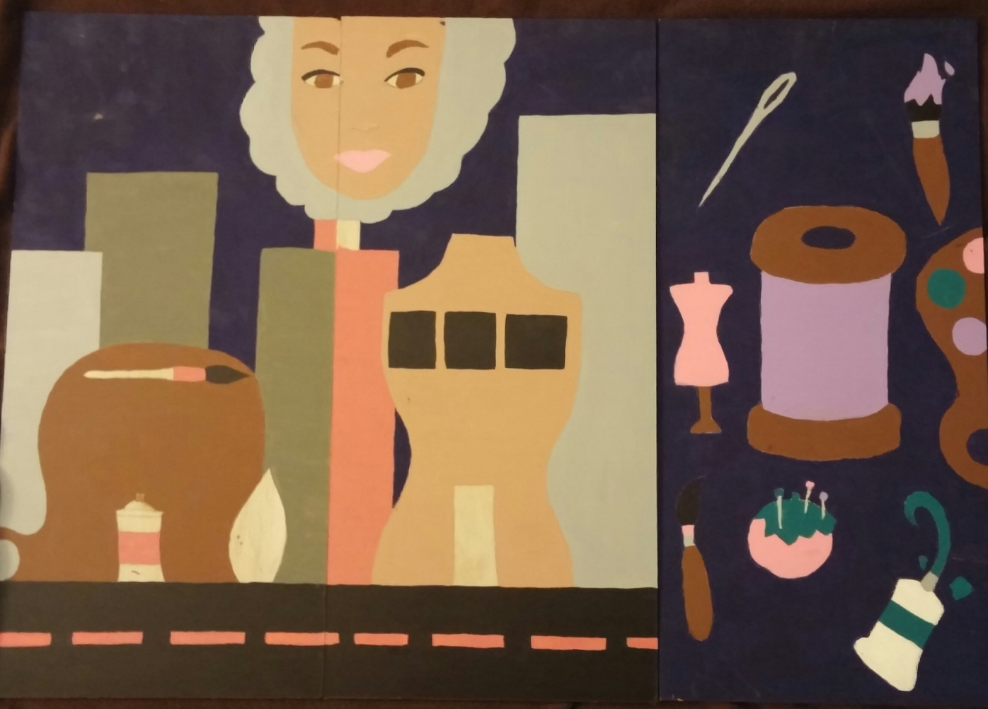
Life
60.96cm x 88.39cm
Acrylic on plywood
January 2015
Isabel Santiago designed and painted this painting, using acrylic paints. She believed that it made sense to incorporate the most important aspects of her life during this period of time. Having a creative mind, different aspects of creativity in her life were put into this painting. Most parts were sneakily added in. This painting was extremely time consuming, however, the end result was well worth the time put in.

Slide 6
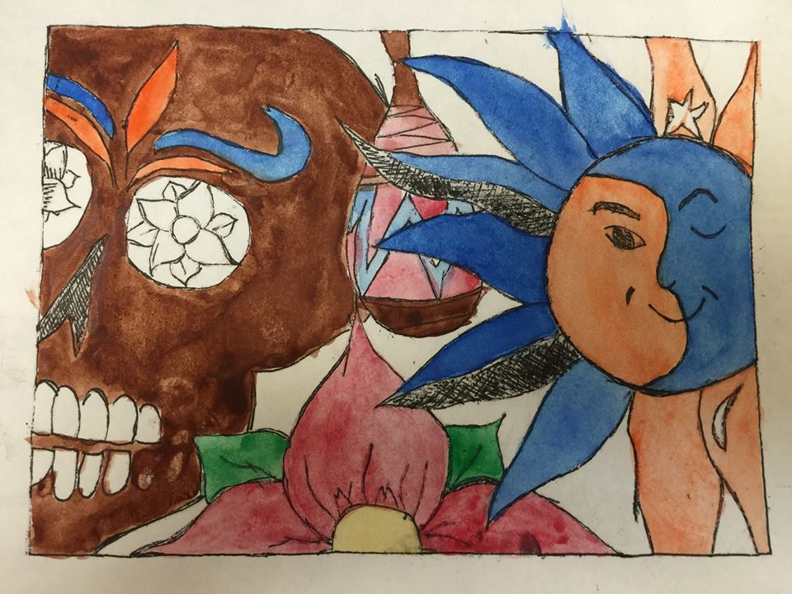
Fiesta
12.7cm x 15.6cm
Ink and watercolor on paper
September 2014
Before creating Fiesta, I figured it would make sense to create a project that relates to my heritage. I didn’t necessarily have any inspiration except for parts of my culture coming together. I almost just figured I’d throw different aspects of the Mexican culture together, but in a well thought out manner. Certain items in Fiesta are understandably a part of the culture, other items are questionable to outsiders.

Slide 7
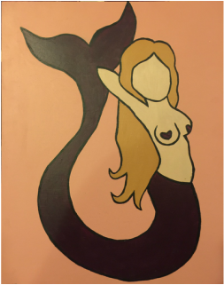
Unidentifiable
50.8cm x 40.64cm
Acrylic on plywood
October 2015
With time, many things can grow better, including this painting. The meanings behind Unidentifiable changed as time progressed and that is exactly what the artist of this painting, Isabel Santiago, strives for in her work. With the use of acrylic paint on canvas, an unidentifiable mermaid was able to be created in the pop art style.

Slide 8
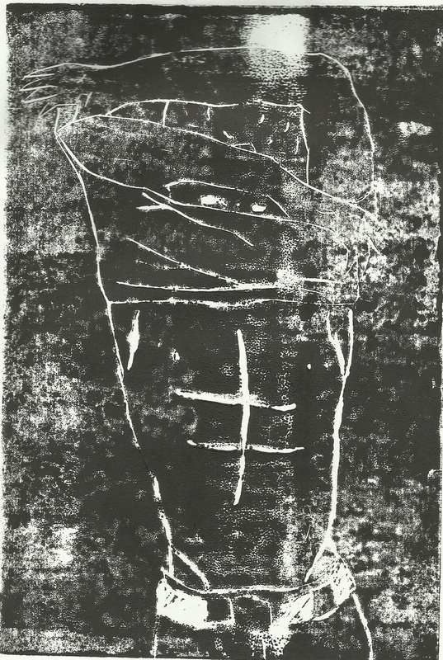
Desire
22.86cm x 15.24cm
Ink on paper
August 2014
Using ink, I was able to create Desire. When I created this particular piece, I was at as point in my life where the human body meant a great deal to me. I was confused as to how someone’s physical features could be so desirable to others, so this inspired me to create this piece. Having the project in black and white left a questions and unresolved emotion toward this piece and that’s what I was aiming towards.

Slide 9
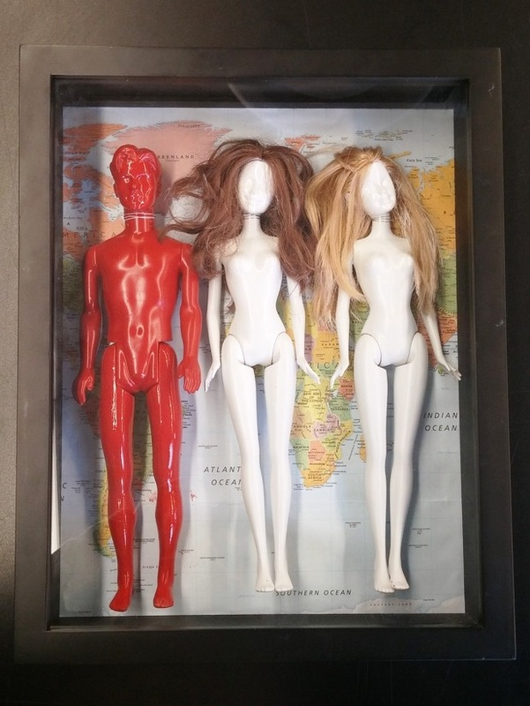
Control
38.1cm x 30.48cm x 8.13cm
Shadow Box
November 2014
Control, was created by Isabel Santiago, but the inspiration came from elsewhere. Jake and Dinos Chapman, commonly known as “The Chapman Brothers” had many odd works of art that inspired this peculiar piece of work. Using different dolls, all three artists, including Isabel Santiago herself, created one of a kind pieces. Tying into most of Santiago’s works of art, this piece also leaves questions with those who have the chance to observe it.

Slide 10
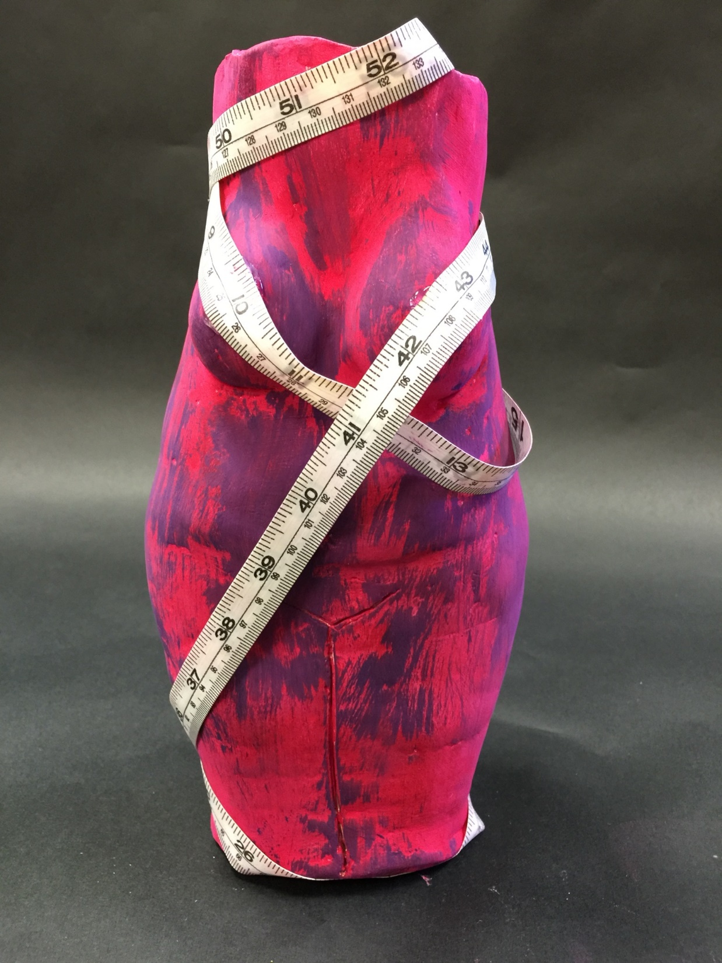
Obsession
26.01cm x 10.922cm x 9.652cm
Oil paint on clay
March 2015
This was a tremendously tedious project for Isabel Santiago. One little mistake would have caused for the whole piece to become a mess. Working with clay was pretty hard for Isabel, since it was a new medium for her. It was all new to her. Adding different parts, such as the larger thighs, the belly, and the tape measure made it clear that a bit of insecurity was poured out onto this work of art.

Slide 11
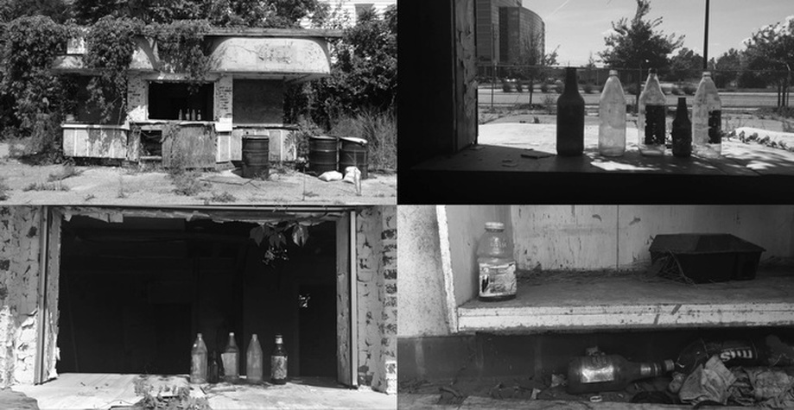
Forgotten America
31.24cm x 58.72cm
Photography Collage
November 2015
The purpose of this collage, created by Isabel Santiago, was to express the forgetfulness of America. This building was one of many vacant buildings found by this artist, however, this particular building peaked her interest far more than the others. Inspired by Matthew Christopher's Abandoned America: an Autopsy of the American Dream, the goal was to find vacant places of her own to photograph.

Slide 12
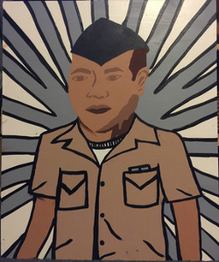
George
60.45cm x 50.8cm ​Acrylic on plywood
September 2015
The artist of this particular piece, Isabel Santiago, set out to create a military based painting, with a bit of inspiration, using acrylic paints. The intention of this painting was to create someone important in her life in her own way. Inspired by Aloysius Patrimonio's Navy Sailor Rifle Binoculars Retro, her painting George captures the look of her loved one. Although this painting was quite time consuming, her visions were captured.

Slide 13
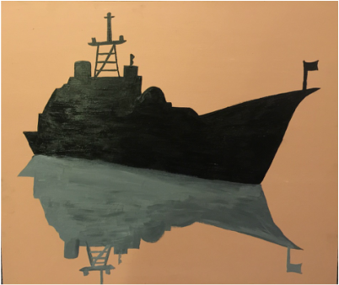
Ship 50.8cm x 60.96cm
Acrylic on plywood
December 2015
Ship was created to stick to the military theme of some of Isabel Santiago's creations. By using acrylic paints on wood, the goal of a ship and its shadow was created. Based off of a bit of inspiration, just as a silhouette of a ship, this piece came to life. Although there are minor flaws, the visions were captured and created to complete this painting of a naval ship.

Slide 14
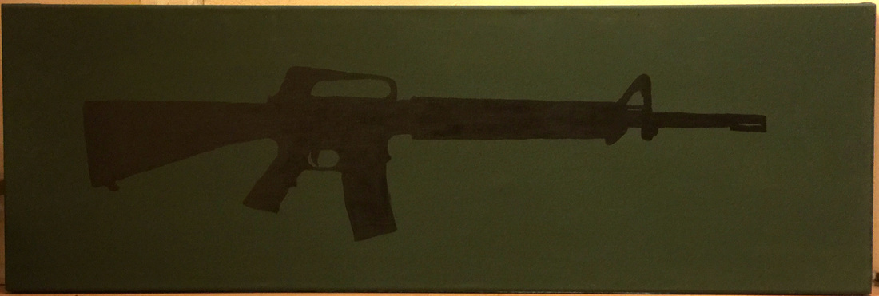
M16A2
30.48cm x 91.44cm ​Acrylic on canvas
October 2015
Using acrylic paints, Isabel Santiago was able to create an accurate copy of an M16A2. Inspired by a silhouette painting of a gun, Shoot to Thrill, by an artist who goes by the name StencilKiller, Isabel Santiago created a similar piece herself, with her own take. She, however, takes a much different take on the theme and doesn't want to incorporate a violent outlook by painting a piece such as her M16A2.​

