Slide 1
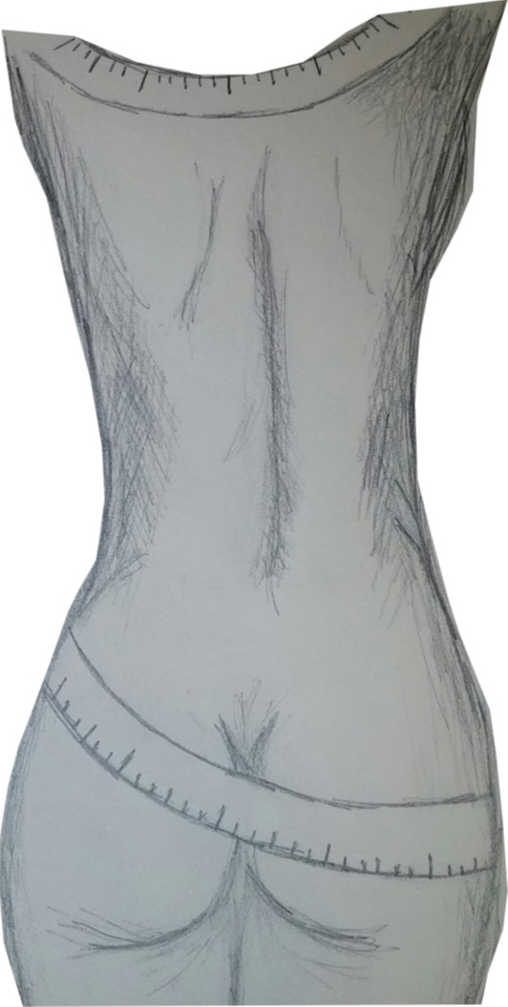
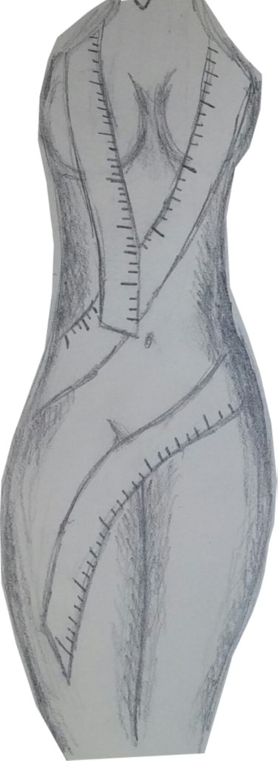
Developing Ideas:
Here I am planning out what I want my overall piece to look like. At this point it was unclear what medium I would use to follow this plan out, so clear sketches of the intention were completely necessary. Both sketches would initially be represented in the end result of this piece, however the two pieces to the right were created using a pencil and shading technique.
The shading was to almost represent the natural shading that would occur once the entire piece was completed. These are when the ideas for becoming a sculpture really began to take action, however, to become a clay piece was not yet in the works. Those ideas progressed once I realized that I liked the whole idea of making this project 3-dimensional.

Slide 2
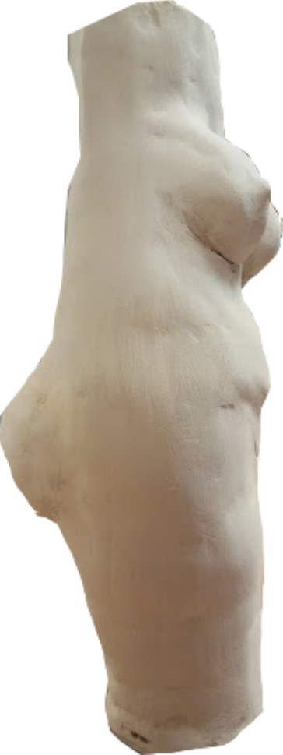
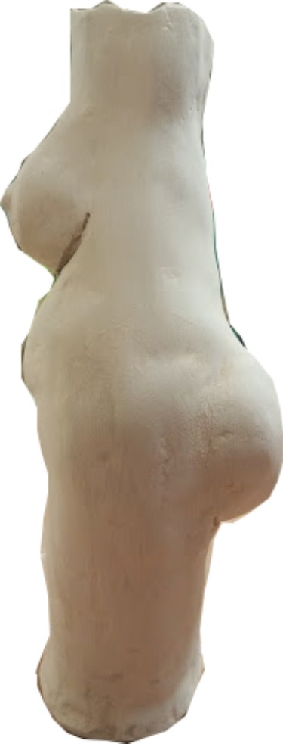
The beginning of the clay process started off extremely bumpy. The edges weren’t smooth and the surface was very rough and rigid, but with this particular piece, that was my goal. Any imperfections were what I was going for since the whole idea of this project was to create an imperfect body- or as I would view an imperfect body at least.
The imperfections were my way of representing the imperfections on the human body. The bumpier, more rigid surfaces could almost represent cellulite because it is not uncommon for one to have cellulite throughout the larger parts of the body.
At this point, the clay was already dry and I had begun to sand it down to get the texture that I wanted to create with it. Using sand paper I was able to create minor flaws throughout the entire clay piece.

Slide 3
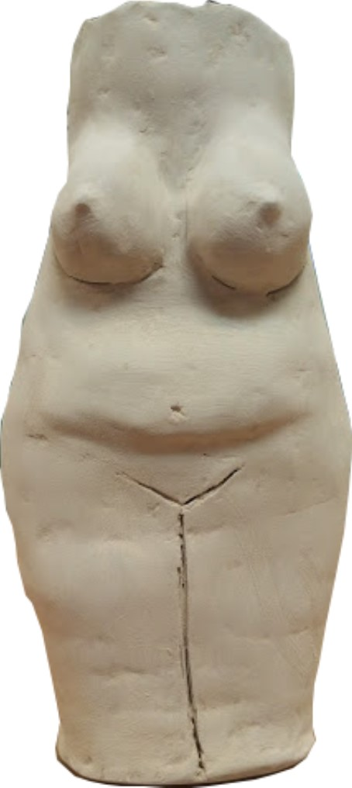
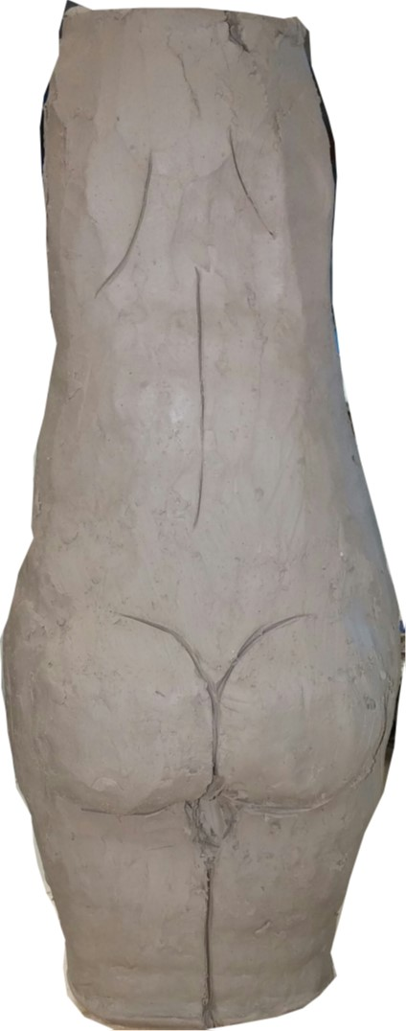
These two progress shots were taken when the clay was still wet, so there was still room for error. I was still in the earlier stages of sculpting the shape and different features in the piece. The main goal and end result was not entirely present thus far in the process, especially since the color was not added yet and the accessory was absent as well. The larger stomach area and the not so perky breasts are becoming present already, though.

Slide 4
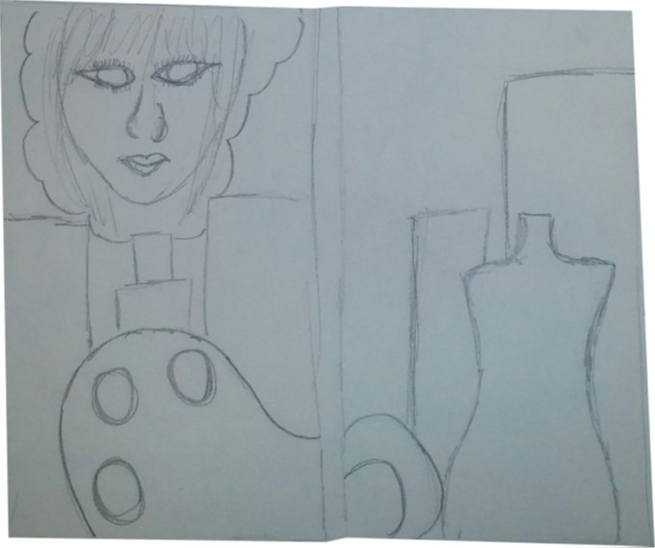
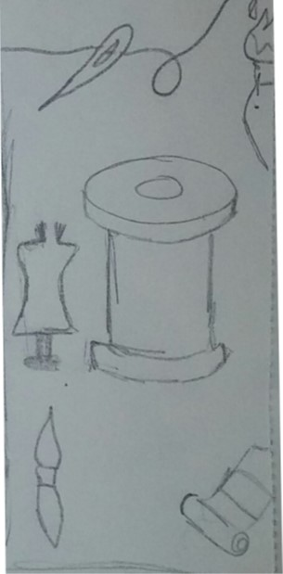
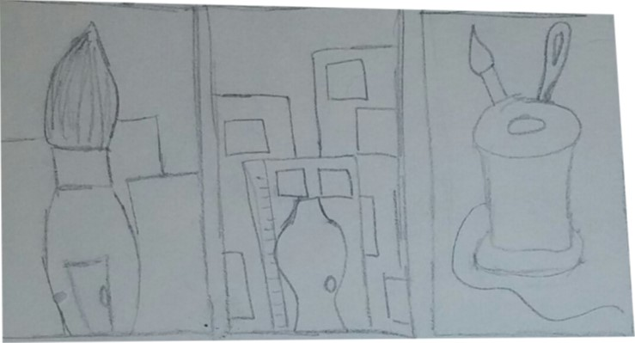
Developing Ideas:
These are just some of the ideas in which I wanted to incorporate in my piece called Life. The spool of thread and the sewing needle represent a huge part of my life and a huge hobby of mine as well as the paintbrushes and the tubes of paint.
Later on I decided to go with the idea to create my face in the smoke of a building, since it was a creative way to put me in the city. I also used the palette as a building and a mannequin as one as well. These aspects really tied the entire piece together in the long run.

Slide 5
The colors in which I used in Life were pretty crucial as well. I wanted all the colors to essentially be the same, just in different shades and hues. Using some of my favorite colors made a lot of sense to me at the time because of the fact that I had never created a piece thus far which was so centered around myself. Different shades and tones of purple are some of my favorite colors so it ultimately made sense to incorporate some of those colors into the piece, all throughout it. Some of the more random colors were put in just to show some contrast in the piece.

Slide 6
Process of Me
In these photos I have shown how I manipulated the contrast of the photo to highlight the key features of my face. On the cheeks, chin, and parts of my forehead were the lightest areas, thus reminding me that these would be the lighter shades in the painting.
Other parts of me, such as my eyebrows, and around my eye area would end up being much darker shades of the color I decided to use in that general area.
Finally, my lips and nostrils would be the medium tone that I chose to use since those are darker areas, however, not the darkest areas on my face.

Slide 7
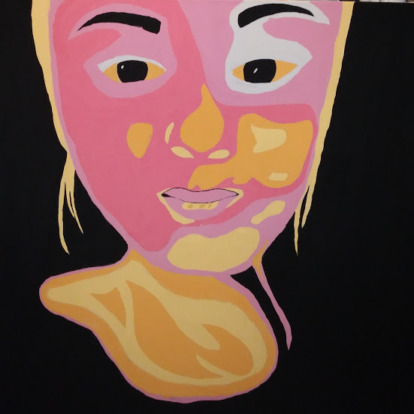
At this point in my self portrait, the background has been painted a solid black color just to allow for a contrast to be extremely present. This way the main focus is the face and all the different shades being put together. The hair was painted a lighter shade, even though it was just as dark as the eyebrows, only because I did not want to take away from the face too terribly much.
This progress shot was clearly not the finished result considering I did outline all of my facial features to make it stand out more in the end.

Slide 8
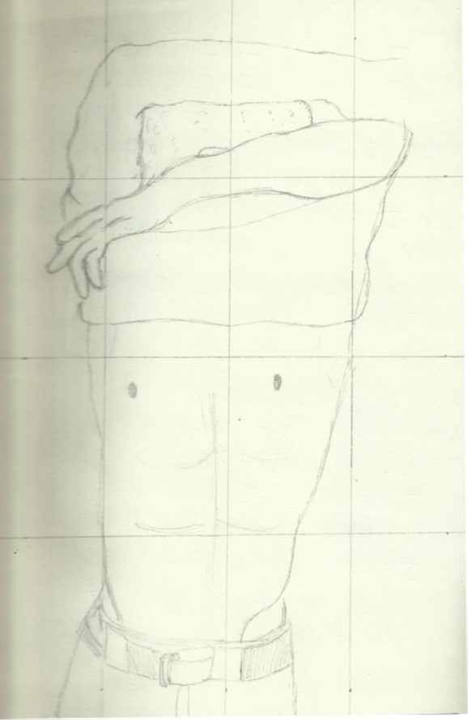
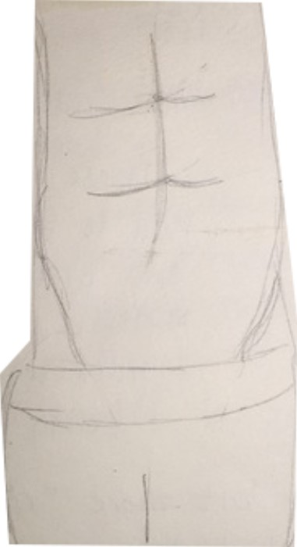
Developing Ideas
The sole purpose was to give the body defined edges and to be as clean cut as possible- almost how a sculpture would look. I intended for everything to look chiseled and desirable. This male body was supposed to look muscular and almost how a male would be defined as “sexy.”

Slide 9
This piece of mine did not have any artist inspiration, however, a cultural inspiration. Inspired by my Mexican heritage, I put together different aspects of what you’d typically see being celebrated in Mexico.
This is quite apparently not the end result since watercolor was not even added to many parts of this piece yet.
The lines are not so defined and the edges are a bit rigid, but it was done in this manner to resemble the reality of this culture, and all others for that matter. It is structured, but only to a certain point. Being able to represent my heritage and cultural background was extremely interested because I was also able to learn things about my heritage that I didn’t know prior to doing some research about it.

Slide 10
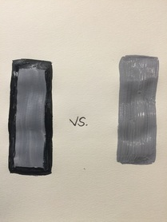
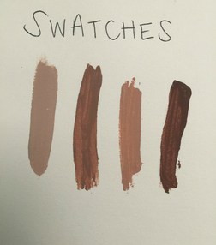
Developing Ideas
OUTFIT CHOICE: Since the men and women in the navy have four different outfits that they wear, it was really up to me to decide which outfit would look best on the background that I chose. OUTLINING: Originally, the plan was not to outline anything, but further thinking it through, to create a piece with a pop-art feel, outlining everything in this painting made most sense.
BACKGROUND COLOR: The background color option was between gray and white, like my inspiration, or navy blue and white, since this is a gentleman who is in the navy.
After completing the painting without outlining a single thing, I realized that the piece felt incomplete. So, I decided to outline only the sailor and his uniform, but doing so made the background feel incomplete as well. After deciding to outline the white and gray stripes in the background, the piece was beginning to come together. After doing this, I also felt as if the lines were a bit more defined as well.

Slide 11
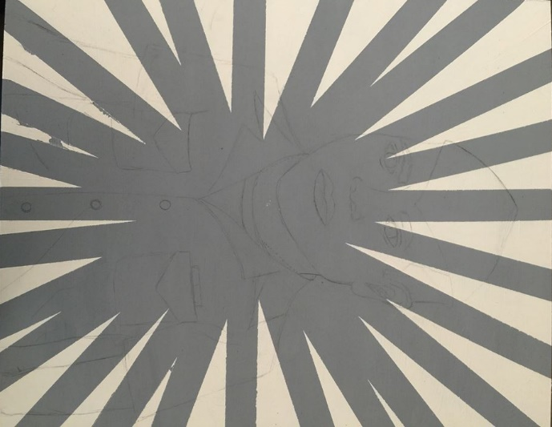
PROCESS: To paint the background was a difficult task to overcome. It was tough to choose whether to paint the sailor first or the background first. After deciding the paint the background first, it was another tough decision to paint the white or gray first, so for no specific reason, I chose the gray first. Then, I taped off the spaces in which I didn't want to be painted white, using painter's tape. The next step was to paint the white and peel off the tape. That idea, however, did not work in my favor since I let the paint dry. Letting the paint dry made it so it dried on the tape as well, so when I pulled off the tape, I also pulled off chunks of paint that should have remained.
After peeling off paint that was supposed to be left in tact, I had to flip around the board to the point where when I painted the sailor over the top, it would cover up the chipped paint. It worked out well in my favor because I then positioned the arms to cover up the parts that the body did not. This way, I was able to make the sailor take up the majority of the board and leave very little extra space compared to the piece I used as my inspiration.
To the left is a detailed shot of how the paint managed to peel completely off underneath the tape.

Slide 12
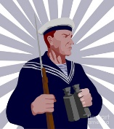
Artist Studies
My artist inspiration to create "George" came from a piece named "Navy Sailor Rifle Binoculars Retro" created by an artist named Aloysius Patrimonio. All of his artwork is created with technology, since he specializes in Digital Art. Due to the fact of his work being digital, the majority of his work is cartoon-like. The fact that he uses a sailor as the main focus completely sparked my interest, mainly because of the fact that before I came across Patrimonio's piece, I already knew I wanted to created a sailor dressed in his Service Khakis, or NSU's. My piece is similar to "Navy Sailor Rifle Binoculars Retro" specifically because of the background that both that piece has and the background which I've created myself for "George." Although his background was also gray and white, in just about the same layout as mine, I outline everything in my piece to give it a "Pop-Art" feel. The artwork I used as inspiration is displayed to the right

Slide 13
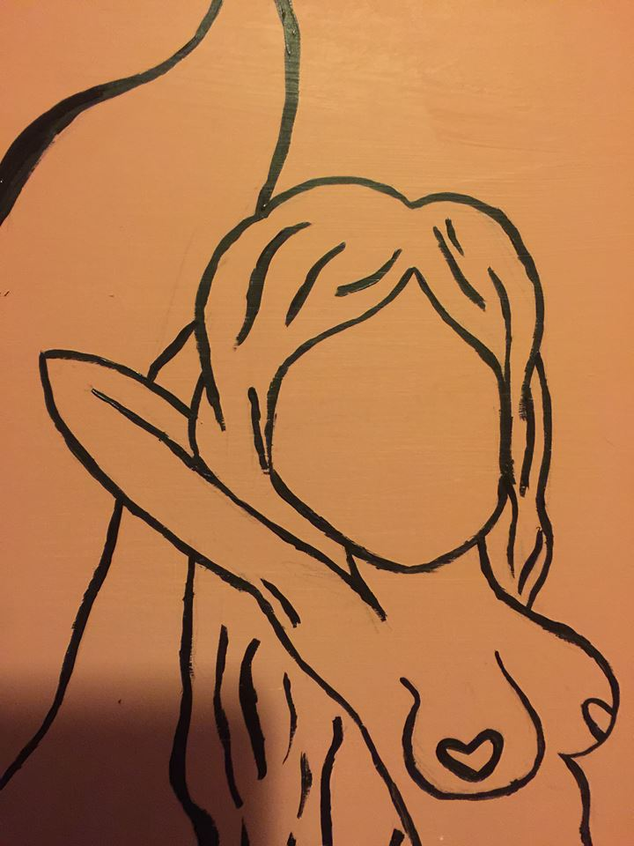
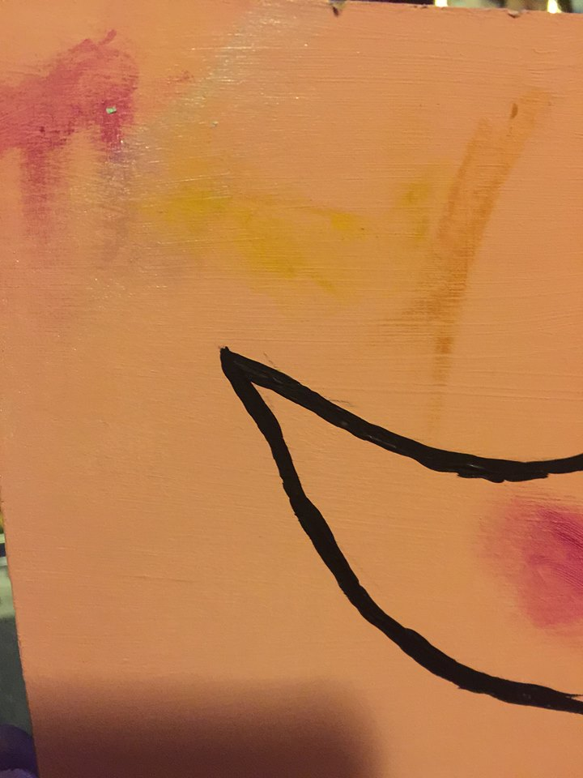
Process
To begin, I sketched out the mermaid that I wanted to paint eventually. I perfected it as much as I wanted until I was ready to paint. Then, I went ahead and outlined, in black, every single line that was currently in pencil. After outlining it, I made some minor tweaks because the sizes weren't to my liking. It was fine to extend the lines and have random black lines across it because the black lines were going to be painted over for the most part. I've learned from past pieces that it's easier to depict dark, thick lines, over pencil. After that step was entirely finished, I had to decide what colors to paint this mermaid. I wanted to make sure the colors would look good against the background color, so on the background is exactly where I tested the colors. I tested different shades of purples and silver for potential tail colors.
I also tested different shades of golds and lighter browns for hair colors and after choosing the perfect hair and tail colors, I painted them into the coordinating areas. After doing so and adding enough coats to make the tail and hair look complete, I began to mix a skin tone. Since the hair color was so golden, I wanted to go with a lighter skin tone, so that's just what I did. By mixing white, brown, red, and yellow, I mixed the perfect shade.

Slide 14
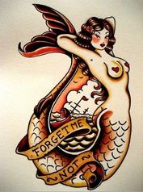
Artist Inspiration
After browsing through different sailor inspired photos and paintings, I came across this gem. It completely inspired me to create a mermaid of my own, but again, in my own style. This is when I came across Susana Alonso's mermaid design and completely fell in love with the ideas behind it. By subtracting some major details from the inspirational piece and adding minor details of my own, I was able to create my own version of this piece.

Slide 15
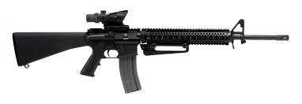
Developing Ideas
SIZE: After deciding to paint an M16A2, it made most sense to create a canvas that had a longer width and shorter height. A canvas sized 3' x 1' was just perfect for this particular piece. COLOR: Since the M16A2 is used in the United States Army, an army green background color was best fit for this piece. DIRECTION: Before starting to sketch out the gun in its entirety, I had to be sure to get it in just the right position. Whether to have it face left or right was the toughest decision, however, after going back and fourth for some time, it looked more appealing to my eyes to have it face the right.

Slide 16
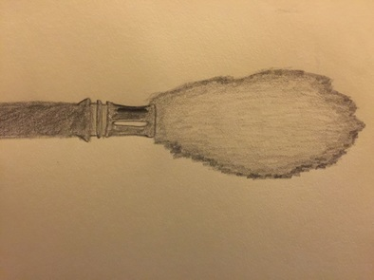
Before I actually started to trace the gun onto the canvas, I had the idea to make it look almost as if the gun was just fired. If this were the case, I'd position the gun all the way to the left side of the canvas in order to leave room for the fireball from the bullet on the right side. However, after thinking the idea through, I didn't want the gun to be fired because in my eyes, it gives off the image of violence or such related ideas. Then as the painting began to come along, the silhouette of the gun looked seemed like a much better idea
In order to make this gun as realistic as I possibly could, I cropped the gun into four parts using only Microsoft Word. I then switched the page from being portrait, to landscape in order to fit more of the length of the gun. After doing just that, I expanded the four pieces to fit the pages completely. This way once I printed these four pages, then put the pieces together, the gun would be large enough to extend across the entire three foot long canvas. After the pieces were printed, I cut out each piece then glued them individually to a large sheet of tag board. After doing that, I once again cut out these pieces and taped them together to form the whole gun. By doing this, it ultimately created a stencil with opposite negative space than a traditional stencil would have.

Slide 17
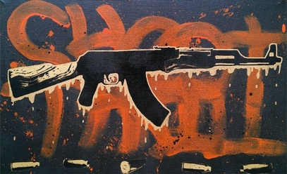
Artist Inspiration
The artwork to the left was one of the biggest inspirations for my painting. The name of this piece is called "Shoot to Thrill" created by StencilKiller and although the message I was trying to portray was the exact opposite of what this title suggest, the silhouette of the gun was exactly what I was going for. I opted out of using the bullets at the bottom of the painting because to me, that suggests that the gun had been fired. Furthermore, this gun is an AK47 and I decided to paint an M16.
To say that we live in a world of peace would be false. Whether one wishes to see it, or to be blind to it, there is cruelty and war everywhere one turns. This does not just occur within the United States, but everywhere in the world as well. We live in a world where evil is something that we just accept. Guns and violence have essentially taken over and either killed off many or have changed the lives of many others forever. Furthermore, we live in a world where guns are basically essential. This painting connects a lot to the lives of nearly everybody. The fact that I painted a black gun on a dark green color pretty much camouflages the gun which ultimately represents how guns tend to go unnoticed.

Slide 18
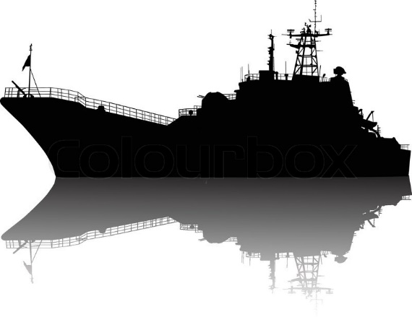
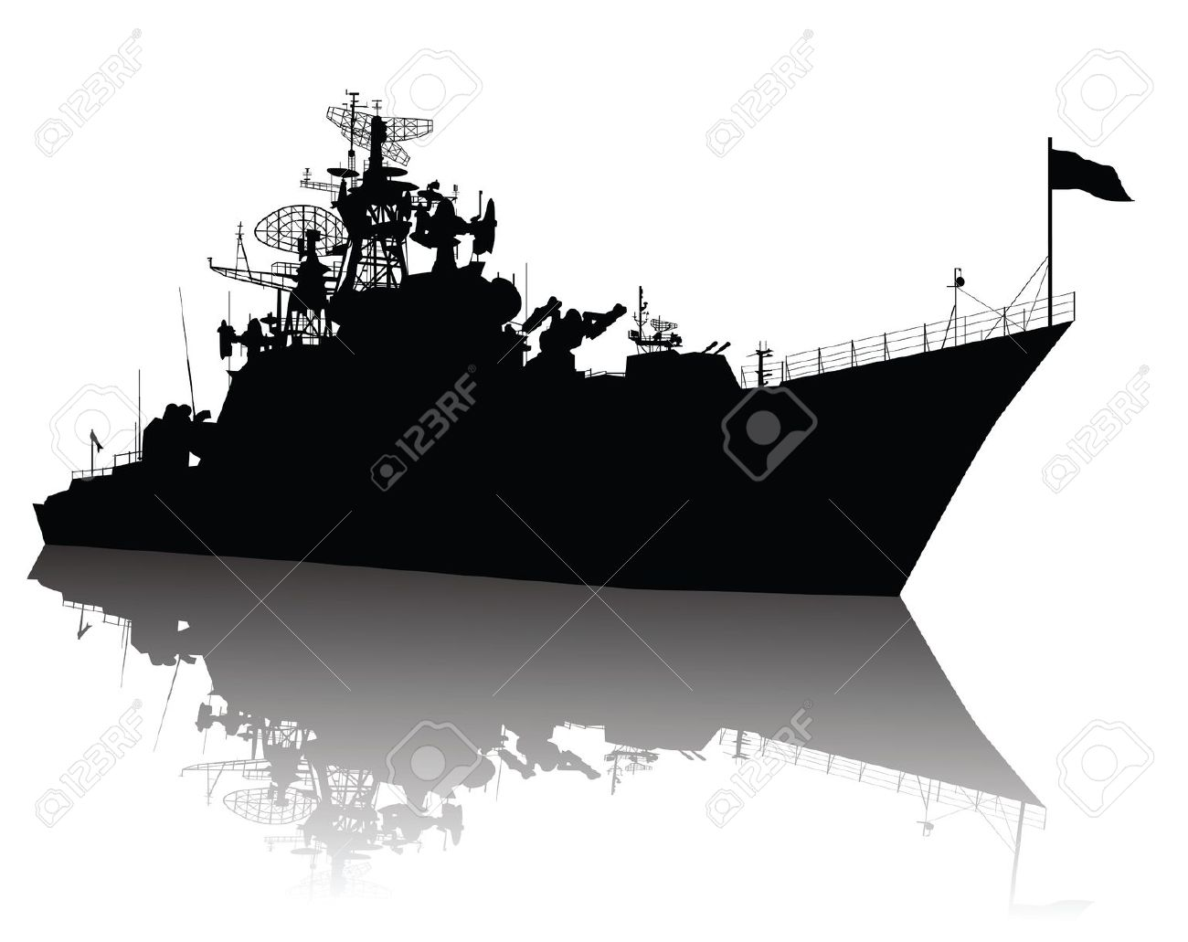
​PLANNING:
To stick with my semi-present military theme, I wanted to created a ship used in the navy. However, I also wanted to stick with my ever so present Pop Art theme as well and not make it so realistic. Furthermore, continuing on with the whole silhouette idea from earlier pieces I've created, I decided it would be a great idea to paint this ship. After researching some navy ship silhouettes online, it became apparent that the vast majority of the better looking ones all had somewhat of a shadow beneath them, so that's what I too wanted to created. I didn't mimic one particular ship completely, rather, putting characteristics of multiple ships into one of my own.
To begin, I left the images- of the three ships I had most interest in- beside me on a monitor and free handed the ship. The hard part came when it was time to created the shadow which had to be just about identical to the ship itself. I distorted the shadow slightly, making certain areas either shorter, or wider. Then once I had a complete outline, I began to paint the actual ship black, then free handed some more minor details. After that step, I mixed my white and black paints and created a few shades of gray to blend together to create the shadow. I then painted the shadow and added some more minor details in with that as well.

Slide 19
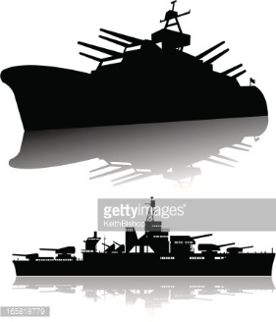
​CONNECTIONS:
With Ship, I have a real-world connection. This is based off the American culture in particular. A large portion of life in America is centered off of our military and creating a naval ship centers the entire painting around the United States Military. These ships are used in battles that protect America from its allies and I wanted to represent them in a piece, since somebody near and dear to me actually lives through this and has the experience firsthand.
Out of all of my pieces created around this time, this by far took the quickest amount of time. That also calls for it being one of my least favorite because the craftsmanship could've been improved to a much greater extent. This piece does, in fact, contain many flaws which could have easily been avoided. The grays were not blended together as well as the could have been and in my eyes, the shadow is so far from being realistic. Overall, Ship​ is not my favorite piece and could use a whole lot of improving.

Slide 20
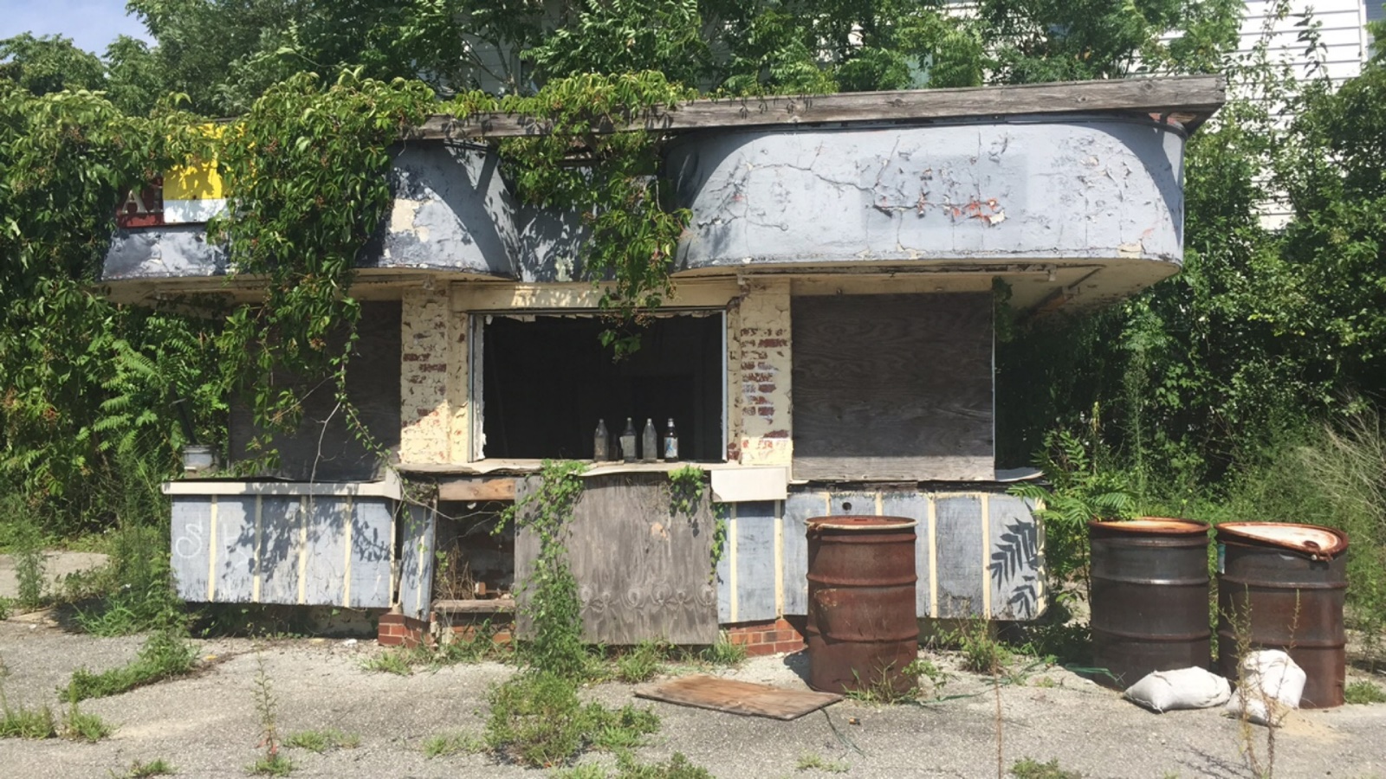
Setting out on this journey, I had the idea and goal to find abandoned locations and capture their true essences. By photographing them, I was able to do just so. With this said, my main goal was to take multiple photos in any location I may come across to capture everything from different angles.
As I began finding more and more buildings, the idea to make this an entire series came to life. Then, to put photos from corresponding locations into collages began to make a lot of sense to me. The idea of changing the photos from a normal color to black and white also came to mind here. This would give my images a more old-time look to them and that's what the main purpose of this project was.

